Slide 1

Driver Drowsiness and Distraction Detection System
Under The Supervision of
Mr. Md. Shakeel Ahmed
Associate Professor
Presented By
B. Jagadeesh – 20BQ1A1217
A.Umesh Chandra– 20BQ1A1205
G.UdaySankarReddy-20BQ1A1255
G.Satish – 20BQ1A1261
Ch.Prakash – 20BQ1A1234
Department of Information Technology
Vasireddy Venkatadri Institute of Technology
Padakakani Mandal, Namburu, Gunturu-522508

Slide 2
Contents Outline
Abstract
Introduction
Existing System with Architecture
Existing System Disadvantages
Proposed System with Architecture
Objectives of Proposed System
System Requitements
Hardware Configuration
Software Configurations

Slide 3
Abstract
The proposed system is an intelligent driver drowsiness and distraction detection system designed to enhance road safety.
By utilizing computer vision techniques and facial landmarks analysis, the system aims to monitor the driver's eye and mouth activities in real-time.
It triggers alarms and alerts the driver when signs of drowsiness or distraction are detected.
The system contributes to reducing the risk of accidents caused by driver fatigue and inattention.

Slide 4
Introduction
Driver fatigue and distractions are major contributors to road accidents. To enhance road safety, the proposed system employs computer vision and facial landmarks analysis.
By monitoring eye and mouth movements in real time, it detects drowsiness and distractions that can impair driving.
The system's use of advanced algorithms and libraries enables accurate evaluation of the driver's state. Key metrics like eye aspect ratio (EAR) and mouth aspect ratio (MAR) provide vital insights.
Alarms and alerts are triggered when these metrics deviate from safe levels, prompting timely corrective action.
This system's proactive approach shows potential in reducing accidents caused by fatigue and distractions, thus making roads safer for everyone.

Slide 5
Existing System
The existing system utilizes libraries such as scipy, imutils, pygame, dlib, and cv2 to build a real-time driver drowsiness detection system.
It processes video frames from a webcam, detects facial landmarks, calculates the eye aspect ratio and triggers alarms when the driver is detected to be drowsy
The system includes features to handle different levels of drowsiness and distraction scenarios.

Slide 6
Existing System Disadvantages
The existing system focuses solely on drowsiness detection, not distraction detection.
It lacks a comprehensive approach to handling different types of distractions.
The system might generate false alarms or fail to detect certain scenarios due to limited feature coverage.
It might not be user-friendly to configure for specific environments or hardware.
The system might need further optimization to work efficiently on various hardware setups.

Slide 7
Proposed System
The proposed system enhances the capabilities of the existing system by introducing distraction detection in addition to drowsiness detection.
It utilizes dlib for face and landmark detection, and calculates the eye and mouth aspect ratios.
The system maintains different timers for drowsiness and distraction detection intervals.
Alarms are triggered based on predefined thresholds and intervals.
Additionally, it provides feedback on the level of drowsiness or distraction detected, offering a more comprehensive solution.

Slide 8
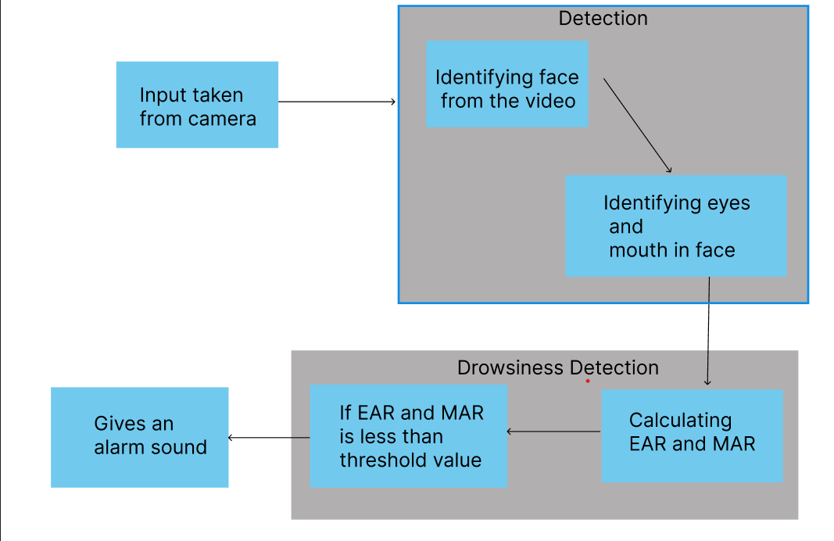
Proposed system with architecture

Slide 9
Objectives of proposed system
Enhanced Safety: Detect both drowsiness and distractions to improve overall road safety.
Accurate Detection: Utilize facial landmarks and aspect ratios for accurate detection of driver states.
Comprehensive Alarms: Trigger appropriate alarms for different levels of drowsiness and distraction.
Timely Alerts: Provide real-time alerts to prompt the driver to take corrective actions.
User-Friendly: Ensure ease of use and configuration for various hardware setups.
Minimize False Alarms: Giving accurate threshold values to reduce false alarms while maintaining sensitivity to genuine issues.

Slide 10
Hardware Requirements
Webcam or camera for video input.
Computer with sufficient processing power and memory for real-time video analysis.
Speakers or audio output device for playing alarms.
CPU : Intel core i3 or higher
Memory : 4GB RAM or above

Slide 11


Software Requirements
Operating System: Windows, Linux, or macOS.
Python interpreter
Required Python libraries: SciPy, imutils, Pygame, Dlib, cv2.

Slide 12
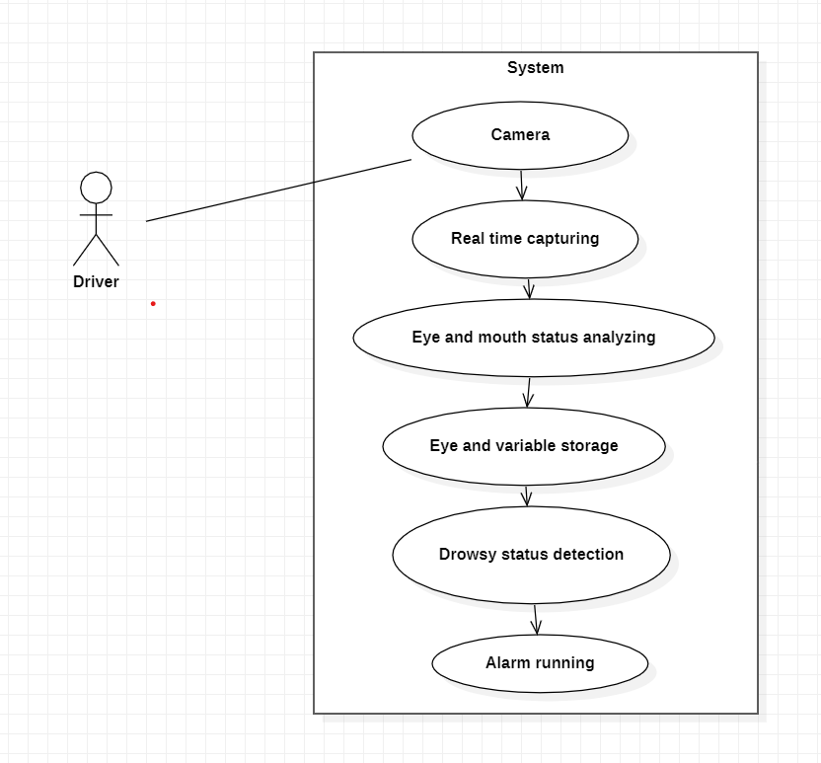
UML Diagrams
Use Case Diagram

Slide 13
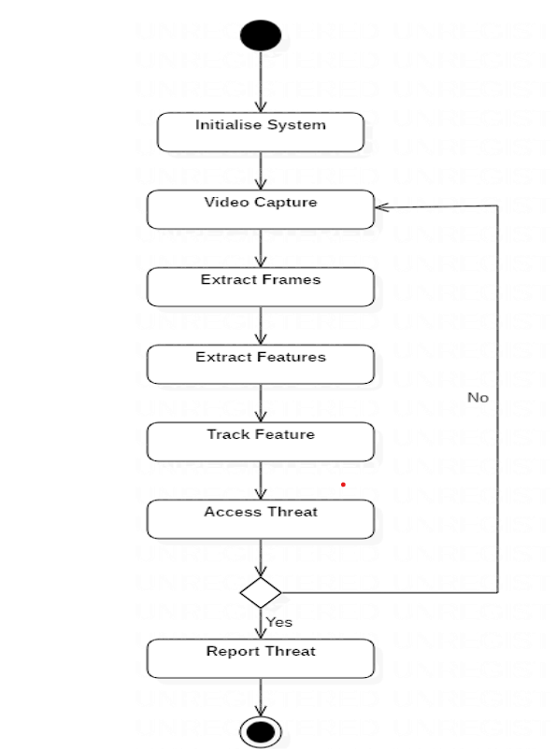
Activity Diagram
AAlarm

Slide 14
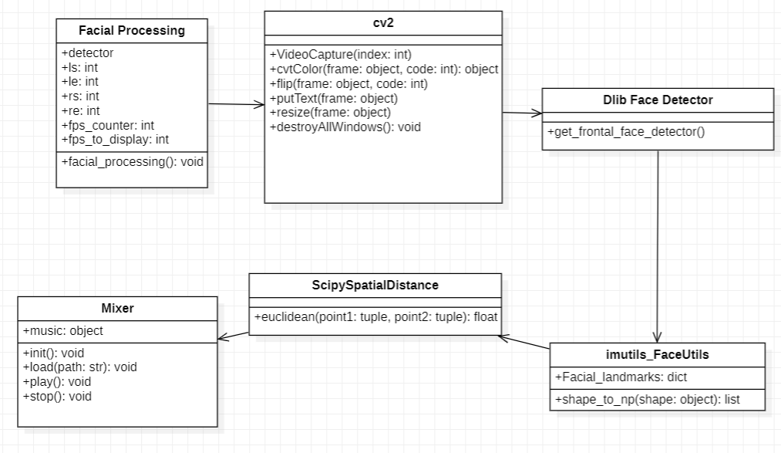
Class Diagram

Slide 15
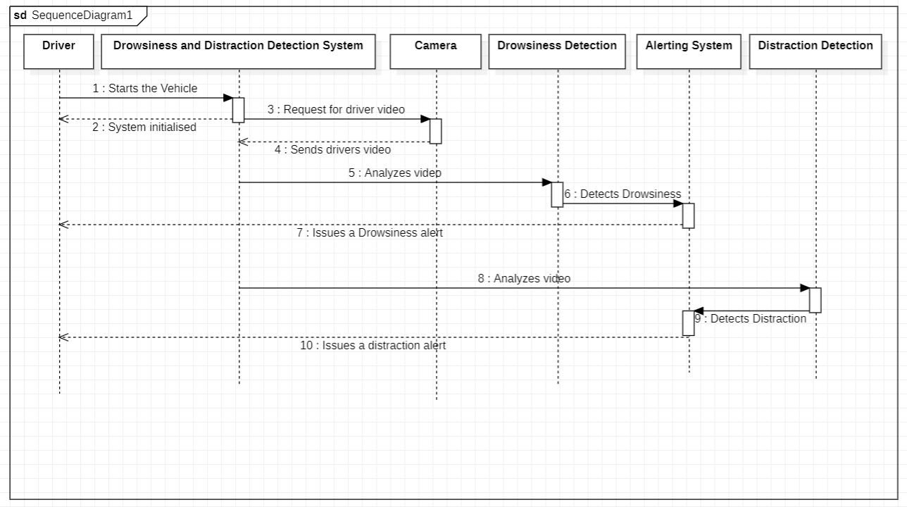
Sequence Diagram

Slide 16
Implementation
MODULES
Module 1: Facial Recognition
This module focuses on accurately detecting and interpreting user hand gestures. Utilizes computer vision libraries such as OpenCV and Mediapipe for real-time hand tracking and gesture recognition.
Module 2: Detection of Drowsiness
This module will identify whether the driver is drowsy or not after detecting the face it analyzes the face which was captured through webcam based on eye and mouth movements of the driver. We have used Dlib library for identifying facial landmarks.
Module 3: Detection of Distraction
This module will identify whether the user is distracted or not after detecting the face through webcam it analyzes the video and checks whether the driver is seeing the road or not.
Module 4: User Interface and Interaction
Ensures a user-friendly and intuitive interaction experience by providing audio feedback. Includes a graphical user interface for user guidance and interaction management.

Slide 17
SOFTWARE & HARDWARE USED
Software Components:
OpenCV: A powerful open-source computer vision library used for real-time hand tracking and gesture recognition.
Dlib: Dlib is a popular library for face detection and facial landmark detection. In the code, Dlib is used to detect faces in the video feed and locate facial landmarks.
Scipy: The distance function from the scipy.spatial module is used for calculating the distances between facial landmarks. This is helpful in determining aspects like eye and mouth aspect ratios.
Pygame.mixer: The pygame.mixer module from the Pygame library is used for playing audio alarms when drowsiness or distraction is detected. This module is useful for multimedia applications.
Hardware Components:
Computer or Laptop: The code is intended to run on a standard computer or laptop, which provides the processing power necessary for facial detection and image processing.
Webcam or External Camera: A webcam or an external camera is required for capturing real-time video frames. The camera should be connected to the computer or laptop.

Slide 18
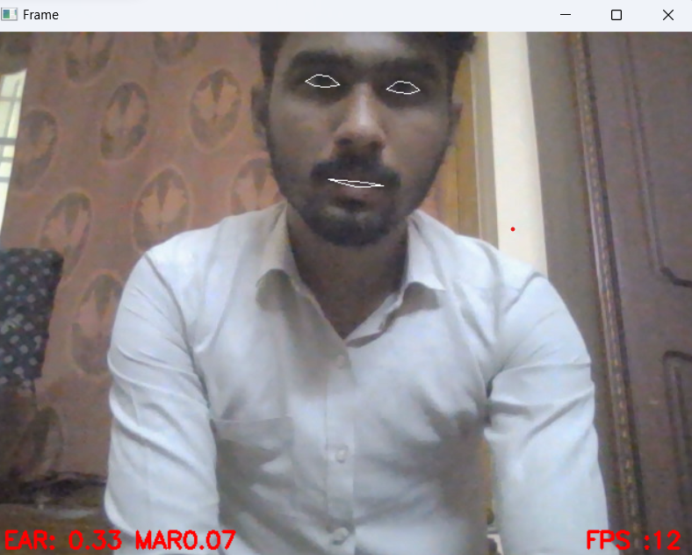
SAMPLE TEST CASES
Test Case 1: Gesture /Finger Tip Recognition
Expected Result:
The system should correctly identify face and should monitor the eye and mouth movements.

Slide 19
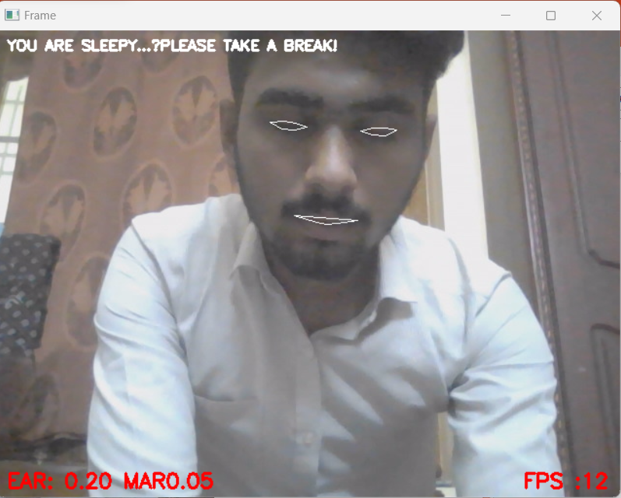
Test Case 2: Detection of Drowsiness.
Expected Result:
The system should accurately identify drowsiness based on eye aspect ratio and mouth aspect ratio.

Slide 20
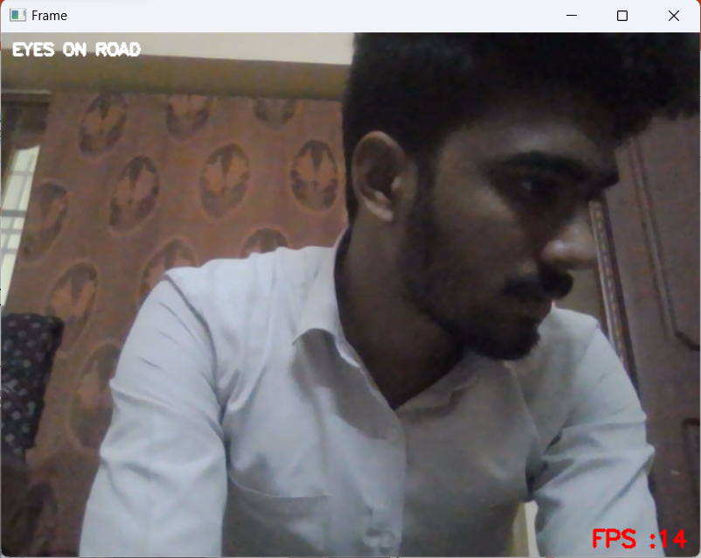
Test Case 3: Detection of Distraction
Expected Result:
The system should accurately identify distraction using facial movements.

Slide 21
OUTPUT
It gives an alarm after detecting drowsiness or distraction

Slide 22
CONCLUSION
This real-time facial monitoring system is a significant step toward making various activities safer, such as driving and healthcare.
It's easy to customize and has the potential for more improvements, like connecting to the internet or understanding changes in how people talk.
This system leverages computer vision techniques and facial landmark detection to address the critical issues of drowsiness and distraction in individuals, alerting them promptly to mitigate potential risks.

Slide 23
FUTURE ENHANCEMENT
Adaptive Alarms : Customize alarm responses based on the severity of drowsiness or distraction. For instance, the system can issue a gentle alert for mild drowsiness and a more urgent warning for extreme cases.
Multi-Modal Sensing: Integrate additional sensors, such as heart rate monitors or EEG sensors, to complement facial monitoring. Combining multiple sources of data can enhance the system's accuracy and reliability in detecting drowsiness and distraction.
Integration with Wearables: Extend the system's functionality to wearables, such as smart glasses or augmented reality (AR) headsets. Users can benefit from real-time alerts displayed in their field of vision.
Alert Preferences: Allow users to customize their alert preferences, including the choice of alarms, alarm volume, and visual cues. Personalized settings can make the system more user-friendly.

Slide 24
REFERENCES
https://www.researchgate.net/publication/371292920_Driver_Drowsiness_Detection
https://www.researchgate.net/publication/333664318_Driver_Drowsiness_Detection_System

Slide 25
Thank you

